Slide 1
History of Evolutionary Thought
Before Darwin (pre 1859)
Darwin (1859)
Theories after Darwin (early 1900’s)
The evolutionary synthesis (1930’s, 40’s)
Biology since the synthesis (1950 on)

Slide 2
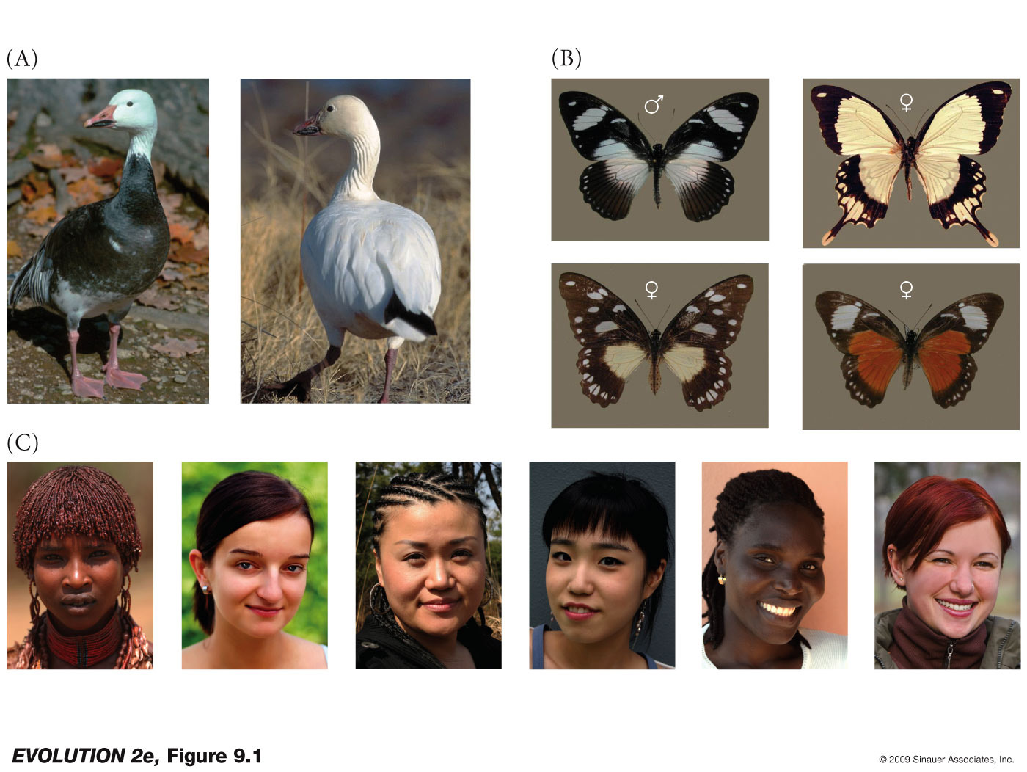
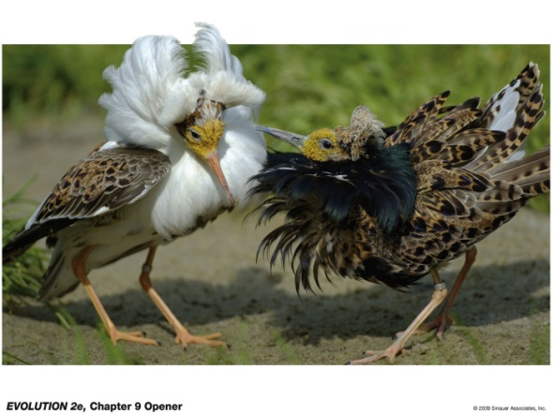
Variation?

Slide 3
Before Darwin
Plato and Aristotle
Concept of eidos ‘form’ or ‘idea’ or ‘essence’
e.g. horses have an immutable (unchangeable) essence, but each individual has its imperfections
This view is called essentialism and under this view variation is accidental imperfection

Slide 4
pre-Darwinian view: variation is accidental imperfection

Slide 5
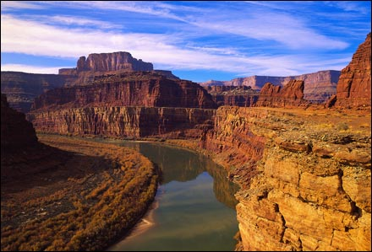
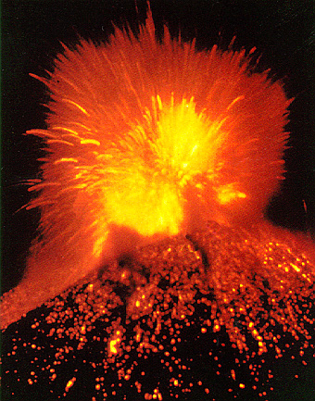
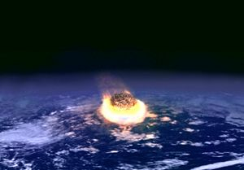
Before Darwin
In the 18th century, there were profound changes in thinking about the nature and history of the earth.
Uniformitarianism – “The present is the key to the past”Championed by geologists Hutton and Lyell.
Catastrophism – Sudden violent and short-lived events were responsible for the current state of the earth.

Slide 6
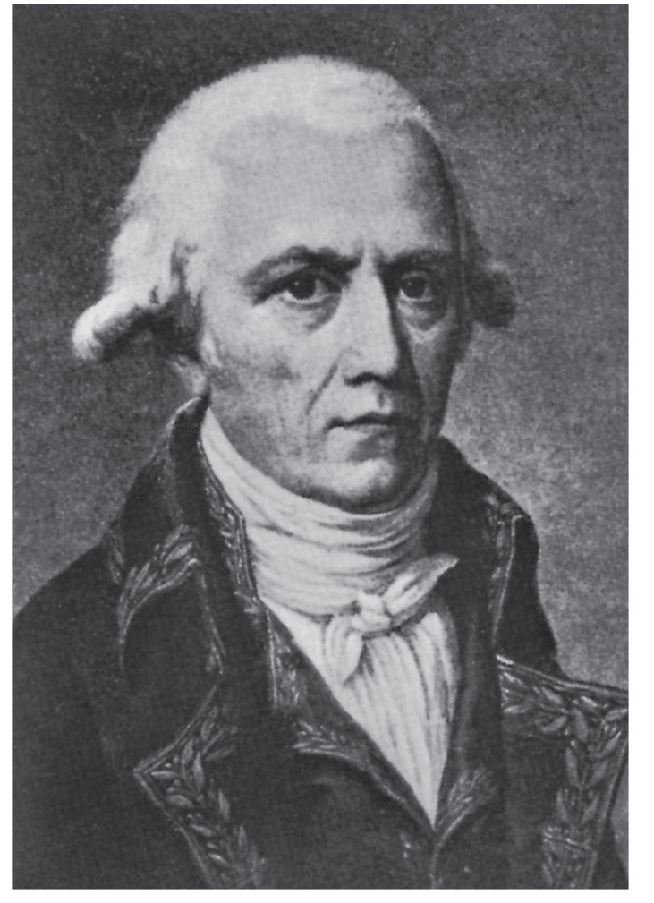
Before Darwin
Jean-Baptiste Pierre Antoine de Monet, Chevalier de Lamarck
Developed theories of phenotypic evolution and of speciation

Slide 7
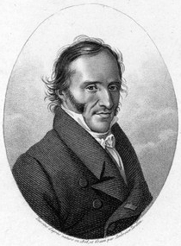
Before Darwin
Georges Cuvier

Slide 8
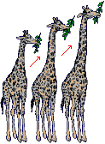
Lamarck’s theory of phenotypic evolution: inheritance of acquired characteristics
Traits acquired during the course of an individual’s lifetime were passed on to offspring
(e.g. lengthening of giraffe’s necks and thickening of a blacksmith’s arms)
generation 1
generation 2

Slide 9
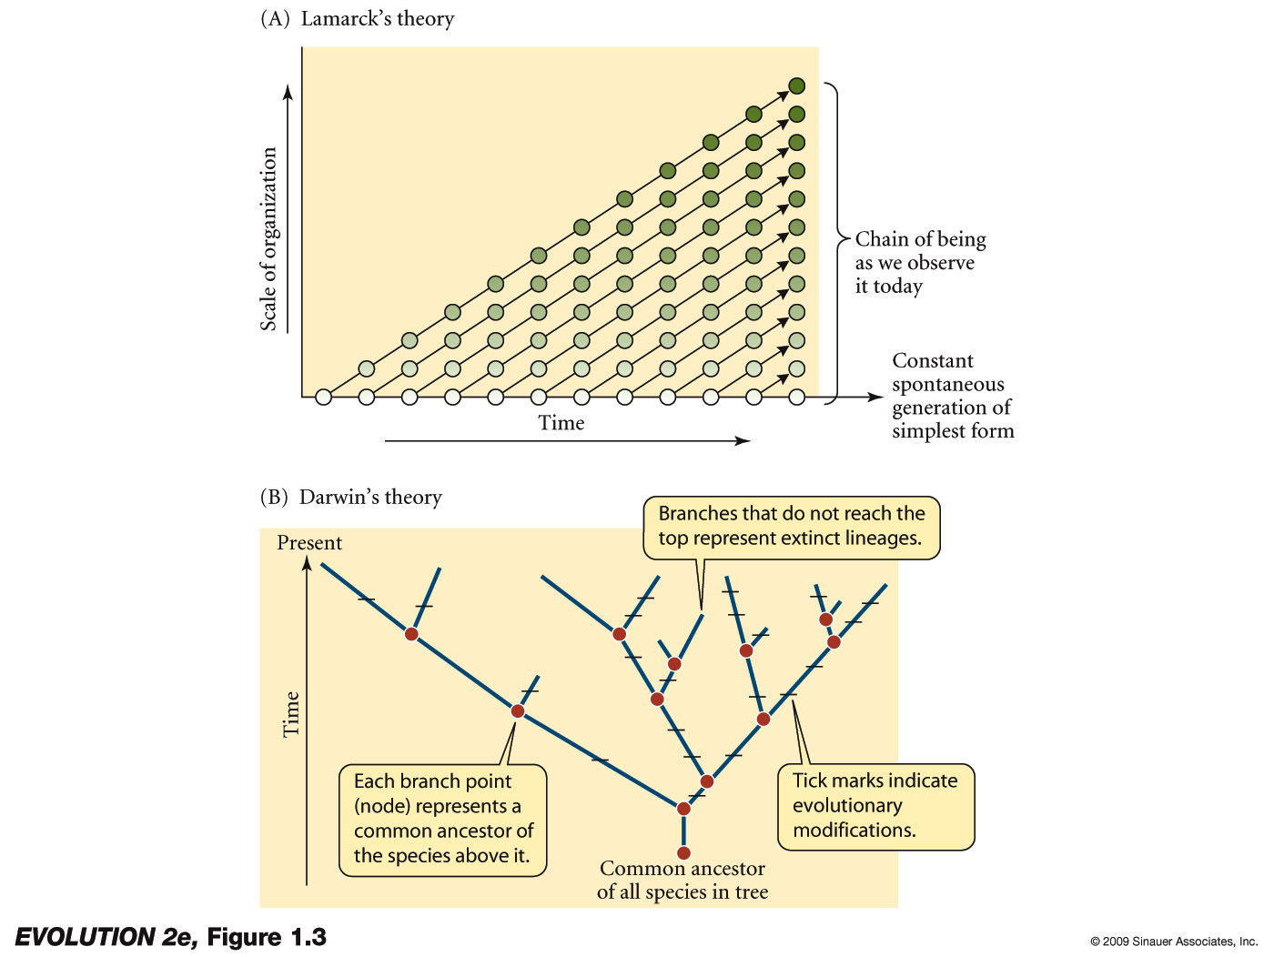
Lamarck’s theory of speciation: species originate by spontaneous generation, and have not originated from common ancestors

Slide 10
Lamarck’s theory of speciation: species originate by spontaneous generation, and have not originated from common ancestors

Slide 11
History of Evolutionary Thought
Before Darwin (pre 1859)
Darwin (1859)
Theories after Darwin (early 1900’s)
The evolutionary synthesis (1930’s, 40’s)
Biology since the synthesis (1950 on)

Slide 12
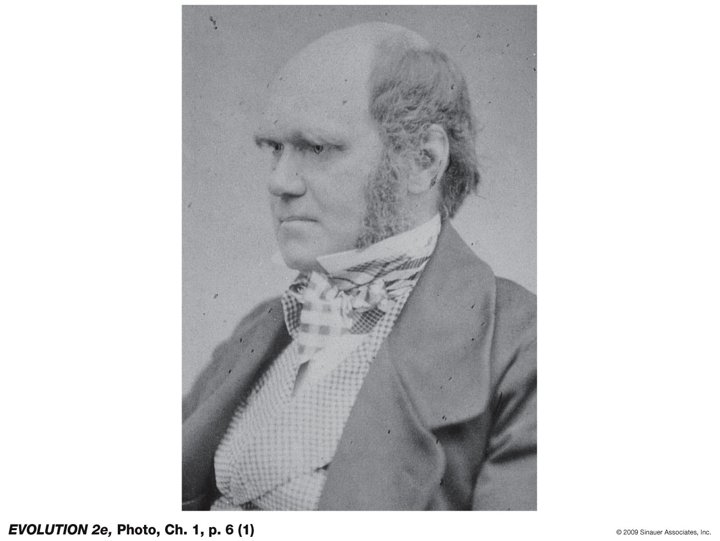
Charles Robert Darwin

Slide 13
Darwin’s life
Lived 1809-1882
Voyage of the Beagle lasted 1831-1836
Darwin became an accomplished naturalist
Theory formulated via INDUCTION

Slide 14
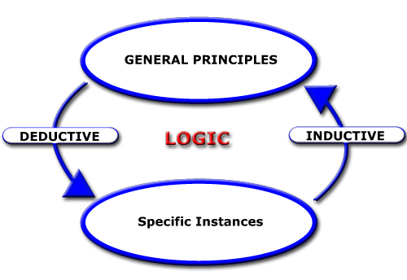

Slide 15
MODEL (HYPOTHESIS)
A formal (mathematical) statement of causal relationships among variables
Induction= using logic to generate expected data patterns
Deduction= modify the model
DECISION
(reject or fail to reject;
Never “accept” or “prove”).
Data can be bad, and
Bad (incorrect) models can be supported by good data!
PREDICTIONS
Measurement= collecting
values of the variables
Comparison (our data against our model-
Do the patterns fit the predictions?
DATA

Slide 16
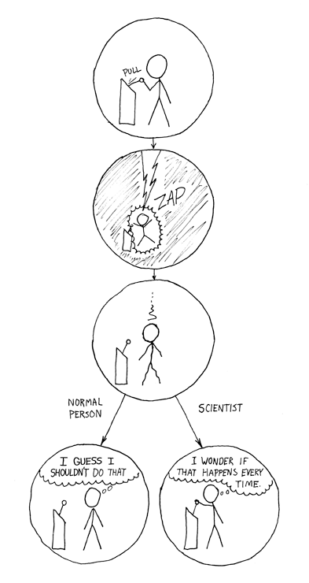
“The difference”
From xkcd.com

Slide 17
Darwin’s life
Lived 1809-1882
Voyage of the Beagle lasted 1831-1836
Darwin became an accomplished naturalist
Theory formulated via INDUCTION
After formulating his theory, he spent much time trying to sort out flaws
Published the Origin of Species in 1859 (>150 years ago!)
The power and brilliance of Darwin’s idea of natural selection is often underestimated
The idea was one of the most important, general, and powerful ideas in the history of thought

Slide 18
The “Origin of Species” actually has two major theses (and five overall theories)
Descent with modification (evolution)
Causal agent of evolutionary change (natural selection)

Slide 19
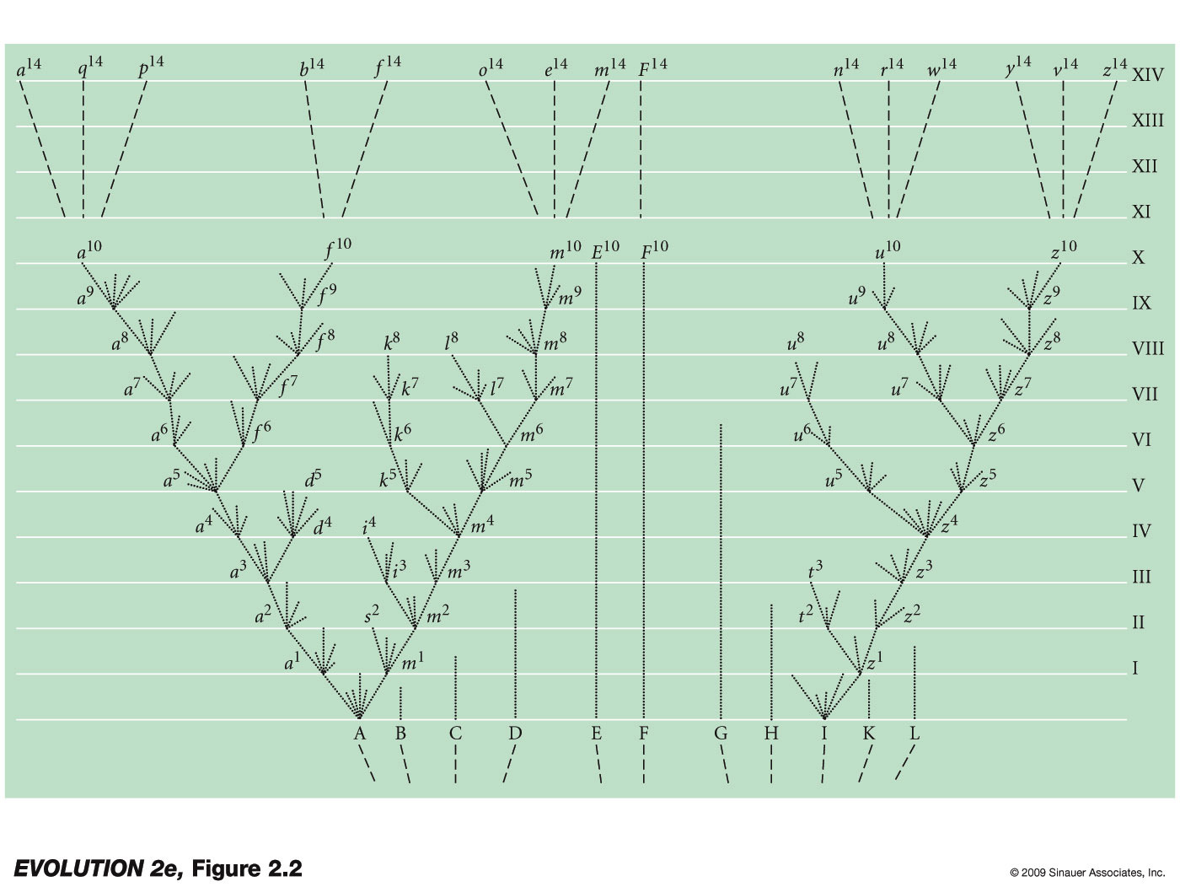
Descent with modification (the only figure in the Origin of Species)

Slide 20
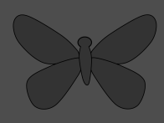

Natural selection as a cause of evolution
Early in generation 1:
Heritable (genetic) differences in
phenotype
Later in generation 1:
Natural selection acts
Generation 2:
Evolutionary change via
natural selection

Slide 21
The “Origin of Species” actually has two major theses (and five overall theories)
Descent with modification - a succinct term to describe biological evolution
Natural selection is differential survival or reproductive success of classes of entities that differ in one or more characteristics. Usually the differences are inherited (and must be inherited for evolution by natural selection)

Slide 22
Darwin’s book actually includes five theories
1) Evolution as such is the simple proposition that the characteristics of lineages of organisms change over time
2) Common descent suggested that all life could be portrayed as one great family tree, this was a radically new view of evolution
3) Gradualism is the proposition that differences between even radically different organisms have evolved incrementally, by small steps through intermediate forms
4) Population change is the thesis that evolution occurs by changes in the proportions of individuals within a population that have different inherited characteristics
5) Natural selection is Darwin’s brilliant hypothesis (independently conceived by Wallace) that the proportional changes described above are caused by differences in their ability to survive and reproduce – and that such changes result in the evolution of adaptations

Slide 23
Darwinian view:
variation is adaptive, evolved by natural selection selection

Slide 24
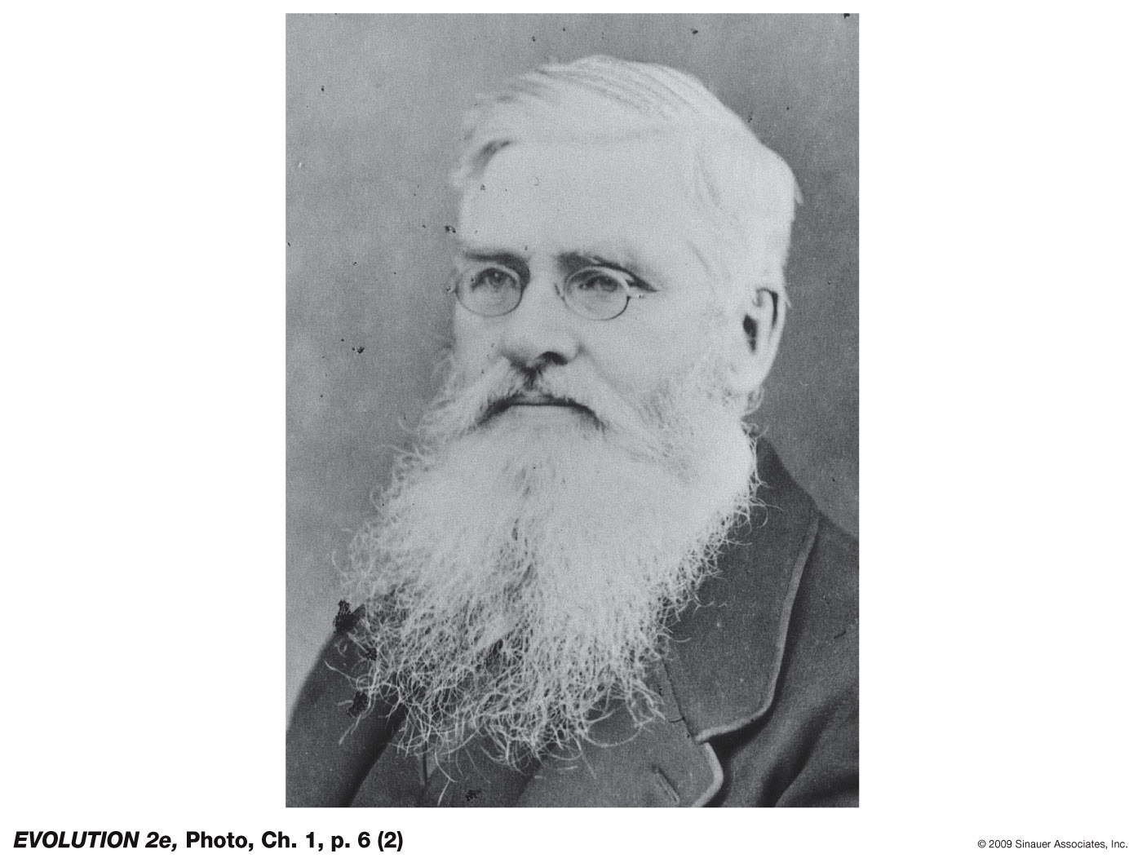
Alfred Russel Wallace
Notes:
Evolution-2e-Photo-01-p007.jpg

Slide 25
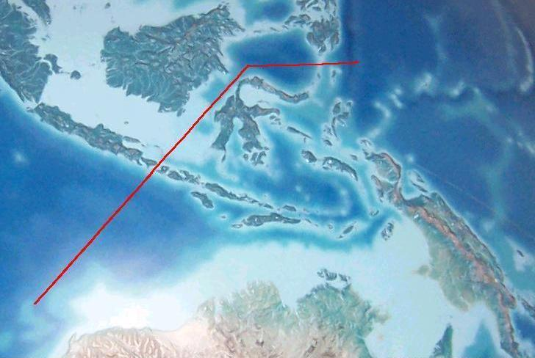
Alfred Russel Wallace
“Father of Biogeography”
- Wallace Line
- also the ‘Wallace Effect’ explanation for speciation
Notes:
Evolution-2e-Photo-01-p007.jpg

Slide 26
History of Evolutionary Thought
Before Darwin (pre 1859)
Darwin (1859)
Theories after Darwin (early 1900’s)
The evolutionary synthesis (1930’s, 40’s)
Biology since the synthesis (1950 on)

Slide 27
Evolutionary theories after Darwin
Theory was initially very controversial
Idea of evolution by common descent eventually accepted
But – the cause of evolution? The idea that natural selection caused evolution was debated
Led to the rise of mutationist theories which argued that discretely different organisms arose via mutation and that natural selection was not required for the origin of new species
Mutation seen as an alternative to natural selection

Slide 28
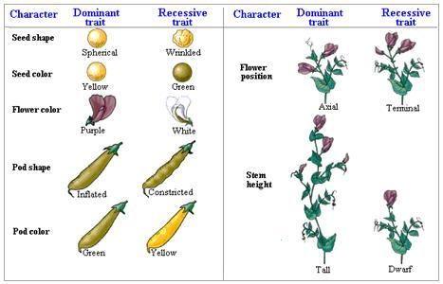
Evolutionary theories after Darwin
Mendelian genetics – “particulate inheritance”
Ideas were published in 1865 but nearly completely ignored…

Slide 29
Richard Goldschmidt (1940) and ‘hopeful monsters’

Slide 30
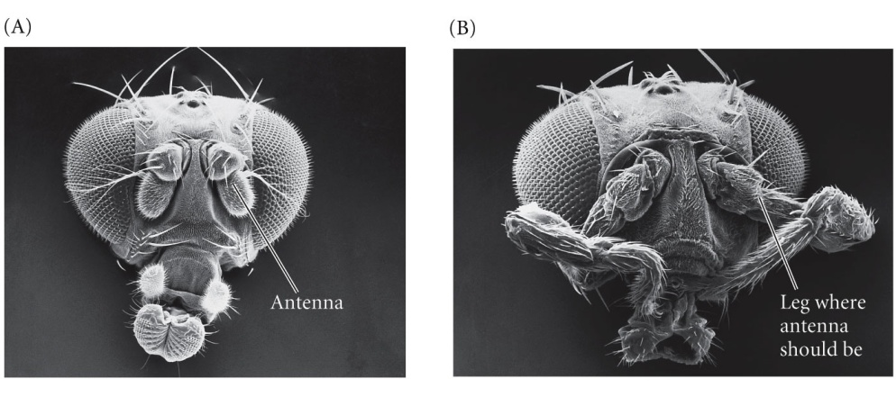
Richard Goldschmidt (1940) and ‘hopeful monsters’
Macroevolution through macromutation

Slide 31
History of Evolutionary Thought
Before Darwin (pre 1859)
Darwin (1859)
Theories after Darwin (early 1900’s)
The evolutionary synthesis (1930’s, 40’s)
Biology since the synthesis (1950 on)

Slide 32
The modern evolutionary synthesis
(1930’s and 40’s)
- Forged from the contributions of geneticists, ecologists, systematists, and paleontologists
- Reconciled Darwin’s theory with the facts of (Mendelian) genetics
- Has been extended, clarified and modified since 1940’s, but is still generally considered fundamentally valid

Slide 33
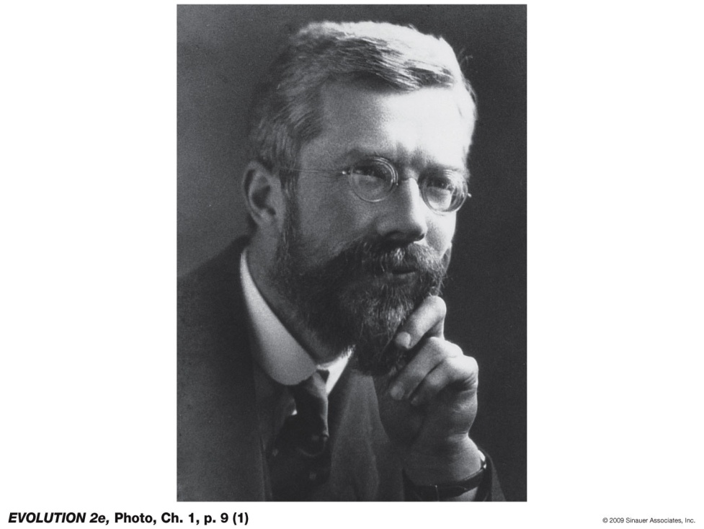
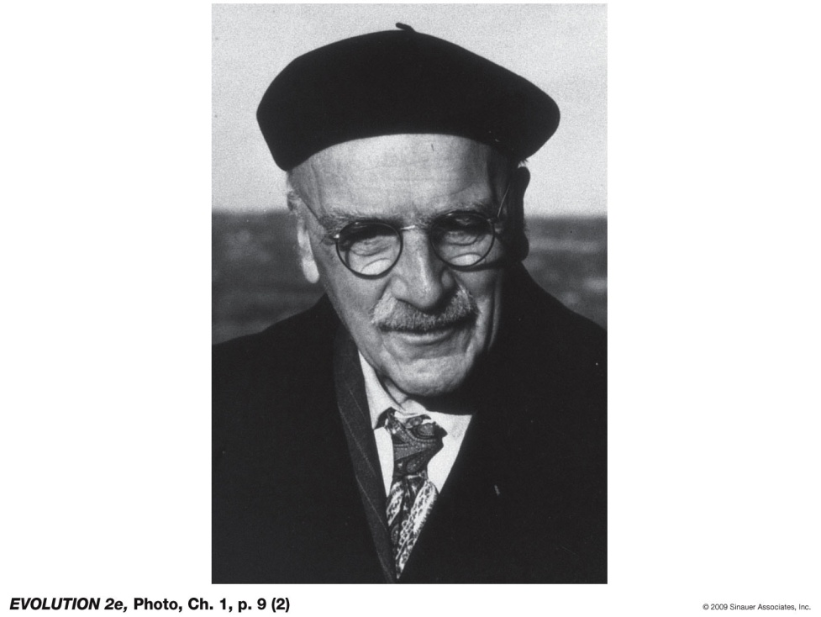
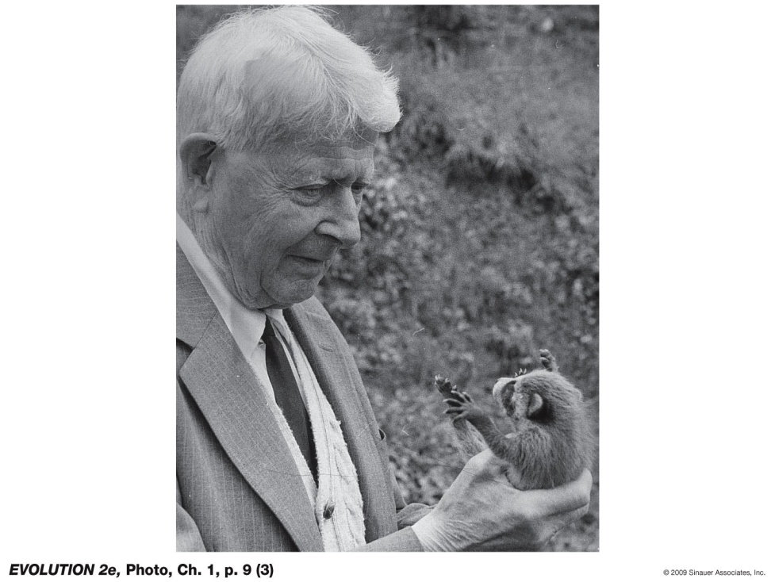
Ronald A. Fisher
J. B. S. Haldane
Sewall Wright
Notes:
Evolution-2e-Photo-01-p009-1.jpg

Slide 34
Ronald A. Fisher, J. B. S. Haldane, Sewall Wright
Developed a mathematical theory of population genetics, which showed that mutation and natural selection together cause adaptive evolution
Mutation is not an alternative to natural selection, but is rather it’s raw material
The relative importance of random genetic changes versus natural selection in evolution was debated

Slide 35
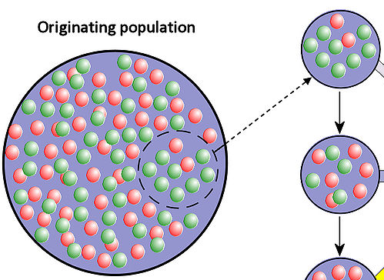
Founder effect and genetic drift
Red = 0.50, Green = 0.50
Red = 0.20, Green = 0.80

Slide 36
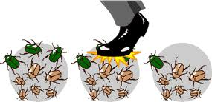
Founder effect and genetic drift
Genetic drift

Slide 37
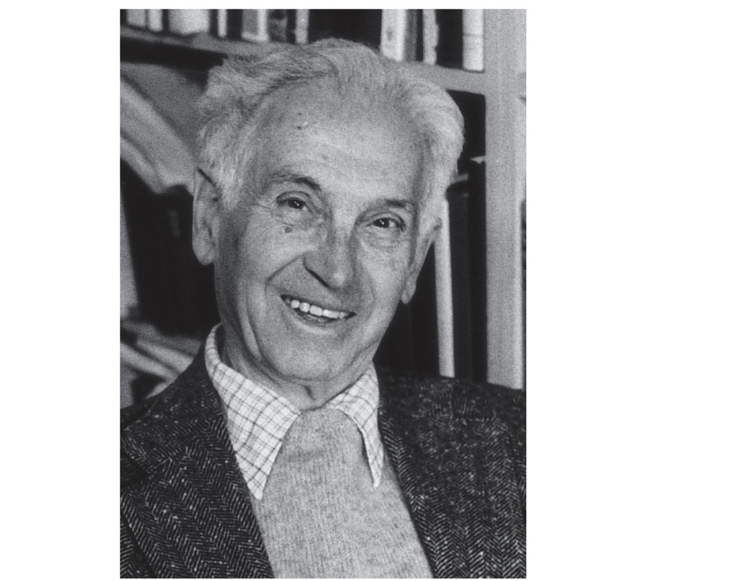
Ernst Mayr
Three major contributions: 1) Biological species concept (BSC) 2) Theory of geographic (allopatric speciation) 3) Theory of founder effect speciation
Notes:
Evolution-2e-Photo-01-p010-1.jpg

Slide 38
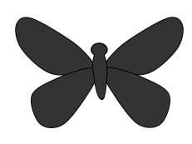
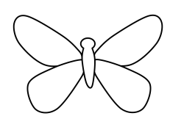
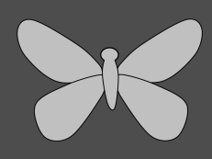
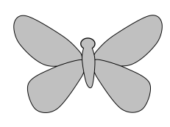

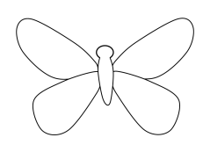
Biological species concept (BSC): species are groups which are reproductively isolated (do not exchange genes) from other groups
premating
postmating
hybrids

Slide 39
Theory of geographic (allopatric) speciation: new species form when populations become geographically isolated, and thus can undergo genetic divergence
YES
NO
NO

Slide 40
Theory of founder effect speciation: drastic reductions in population size promote speciation (e.g. ‘genetic revolutions’)
continent
island

Slide 41
Fundamental principles of evolution (major tenets of modern synthesis)
Forgive me, I know lists are boring, and I will try to minimize their use, but these principles are the foundation of evolution and will be revisited, time and time again, as we move through the course….

Slide 42
Fundamental principles of evolution (major tenets of modern synthesis)
The phenotype (observed characteristics) is different from the genotype (the set of genes in an individual’s DNA); phenotypic difference can be partly due to genetic differences and partly due to direct (within generation) effects of the environment
Heredity variation are based on particles – genes – that retain their identity as they pass through generations
Evolutionary change is a populational process that entails changes in the proportions or frequencies of individual organisms with different genotypes

Slide 43
Fundamental principles of evolution (major tenets of modern synthesis)
4) Genes mutate at a low rate, typically too low a rate to cause a population to shift from one genotype to another; thus shifts occur instead by random fluctuations (genetic drift) and nonrandom changes due to natural selection
5) Even a slight amount of selection can bring about substantial genetic changes, thus selection can account for both slight and extreme genetic differences
6) Mutations can accumulate in populations, thus populations harbor genetic variation

Slide 44
Fundamental principles of evolution (major tenets of modern synthesis)
7) Differences between populations and species are often adaptive (evolved due to natural selection) and are based on differences at several or many genes of small effect (evolution occurs by small steps)
8) Species are characterized by barriers to genetic exchange and interbreeding (reproductive isolation), and usually evolve in geographic isolation
9) All organisms form a great “tree of life” or phylogeny. All forms of life have descended from a single common ancestor in the remote past

Slide 45
History of Evolutionary Thought
(these topics revisited through the course)
Before Darwin (pre 1859)
Darwin (1859)
Theories after Darwin (early 1900’s)
The evolutionary synthesis (1930’s, 40’s)
Biology since the synthesis (1950 on)

Slide 46
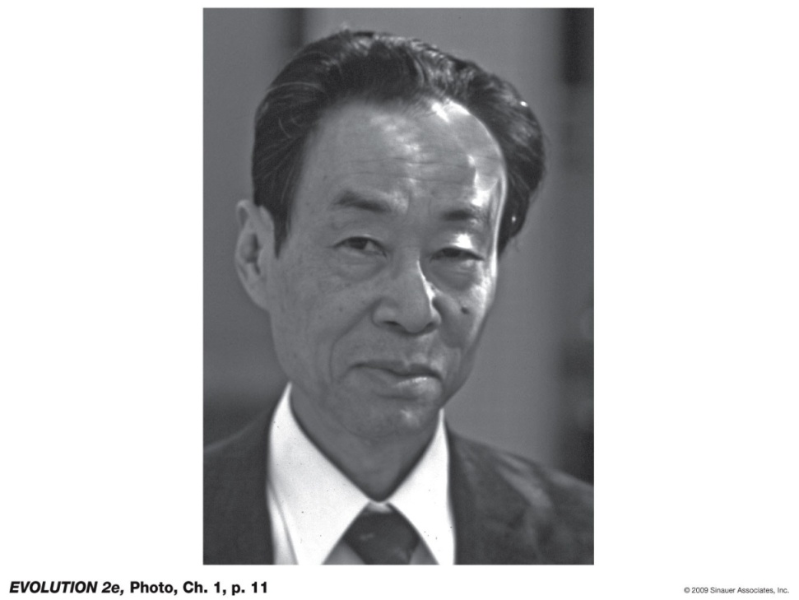
Motoo Kimura and the Neutral Theory of Molecular Evolution
Natural selection requires phenotypic variation to act upon
But many genetic changes cause no phenotypic change (do not produce phenotypic variation)
Led to the hypothesis that
most of the evolution of DNA sequences occurs by genetic drift, rather than natural selection
Notes:
Evolution-2e-Photo-01-p011.jpg

Slide 47
The Genetic Code (DNA)
“Wobble” position and DNA nucleotide substitutions which do NOT change the protein (amino acid)
TTT | Phe |  | TCT | Ser |  | TAT | Tyr |  | TGT | Cys
TTC | Phe |  | TCC | Ser |  | TAC | Tyr |  | TGC | Cys
TTA | Leu |  | TCA | Ser |  | TAA | STOP |  | TGA | STOP
TTG | Leu |  | TCG | Ser |  | TAG | STOP |  | TGG | Trp
CTT | Leu |  | CCT | Pro |  | CAT | His |  | CGT | Arg
CTC | Leu |  | CCC | Pro |  | CAC | His |  | CGC | Arg
CTA | Leu |  | CCA | Pro |  | CAA | Gln |  | CGA | Arg
CTG | Leu |  | CCG | Pro |  | CAG | Gln |  | CGG | Arg
ATT | Ile |  | ACT | Thr |  | AAT | Asn |  | AGT | Ser
ATC | Ile |  | ACC | Thr |  | AAC | Asn |  | AGC | Ser
ATA | Ile |  | ACA | Thr |  | AAA | Lys |  | AGA | Arg
ATG | Met* |  | ACG | Thr |  | AAG | Lys |  | AGG | Arg
GTT | Val |  | GCT | Ala |  | GAT | Asp |  | GGT | Gly
GTC | Val |  | GCC | Ala |  | GAC | Asp |  | GGC | Gly
GTA | Val |  | GCA | Ala |  | GAA | Glu |  | GGA | Gly
GTG | Val |  | GCG | Ala |  | GAG | Glu |  | GGG | Gly

Slide 48

Motoo Kimura and the Neutral Theory of Molecular Evolution
This hypothesis holds that
most of the evolution of DNA sequences occurs by genetic drift, rather than natural selection
But, it provides a foundation for detecting natural selection on DNA sequences
Notes:
Evolution-2e-Photo-01-p011.jpg

Slide 49
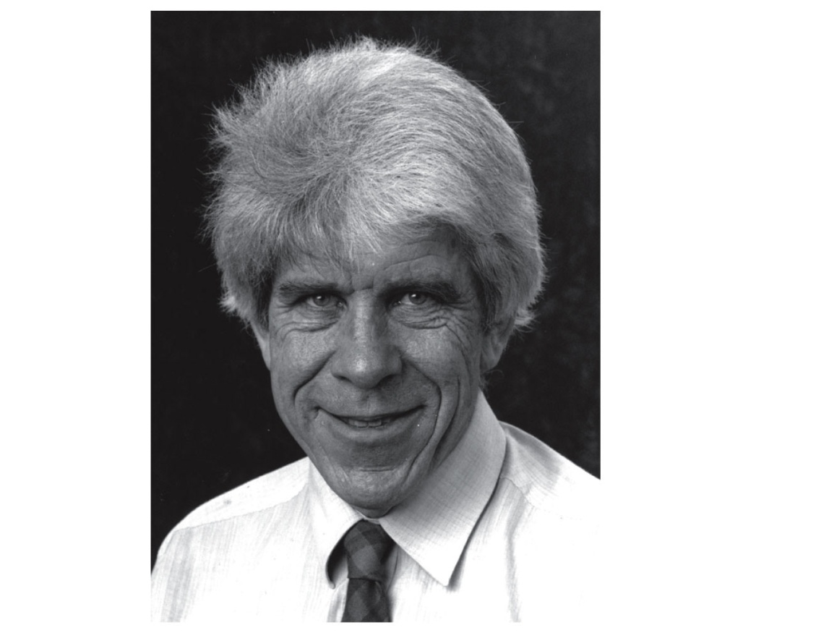
William D. Hamilton, Robert Trivers, and Social Theory
Cooperation – Kin selection (explains confusing altruistic behaviors and eusociality)
Conflict – parent/offspring, sibling, male/female
Notes:
Evolution-2e-Photo-01-p012.jpg

Slide 50
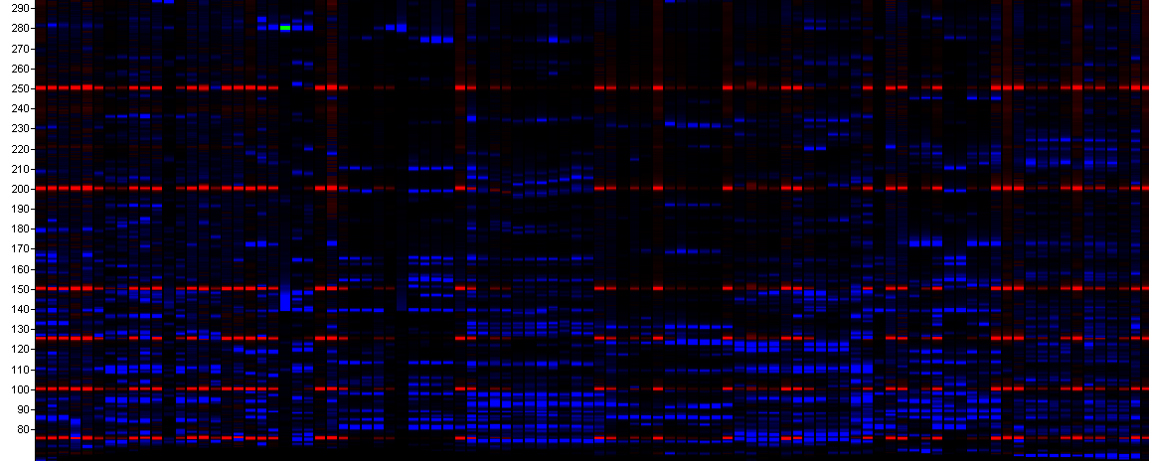
Now…. The age of genomics (a new age of INDUCTION)
new insights into the size, organization and structure of genomes
in turn, this information yields insight into the causes and consequences of evolution

Slide 51
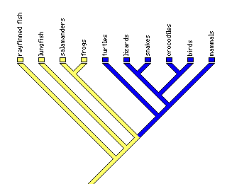
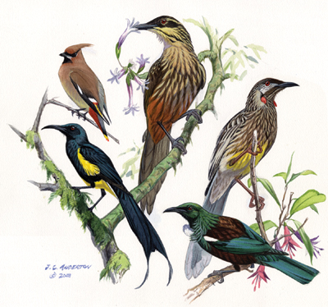
Taxonomy and Systematics

Slide 52
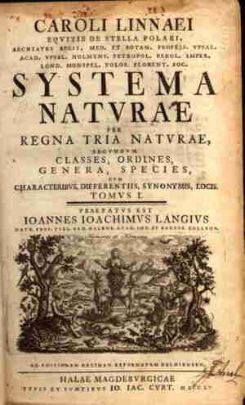
Taxonomy and Systematics
1) Some terminology
2) Taxonomy: concepts and history
3) Systematics and phylogenetic trees
4) Methods of inferring phylogenies

Slide 53
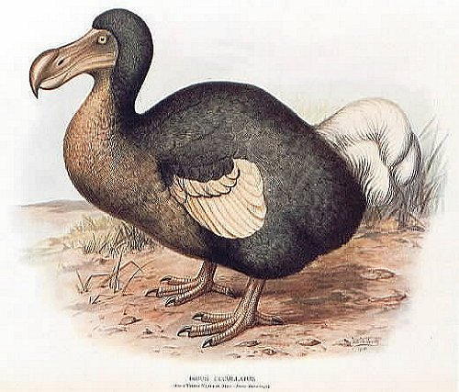
Taxonomy and Systematics
Some terminology:
Taxonomy – the science of describing, naming, and classifying organisms.
Taxon (plural = taxa) – a unit of taxonomic classification
Systematics – the study of biological diversity and the evolutionary relationships among organisms.
Testing hypotheses about which groups have descended from a common ancestor
Extinct – no longer present
Extant – taxa that exist today

Slide 54
Terminology (continued):
Phylogeny – the history of descent of a group of taxa from their common ancestors. (phylogenetics = study of phylogenies).
The diagrams that depict phylogenies are phylogenetic trees. A phylogenetic tree is a systematic hypothesis.

Slide 55
Taxonomy and Systematics
1) Some terminology
2) Taxonomy: concepts and history
3) Systematics and phylogenetic trees
4) Methods of inferring phylogenies

Slide 56
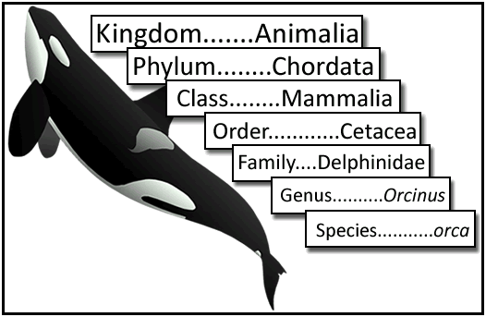
Taxonomy
Used to organize groups of species into progressively smaller hierarchical groups.
Originally Kingdom was the most inclusive taxonomic group

Slide 57
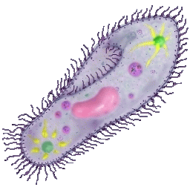
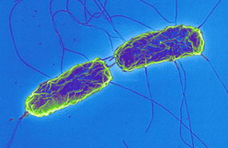
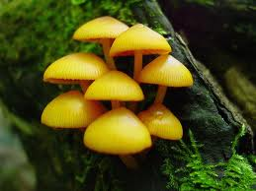
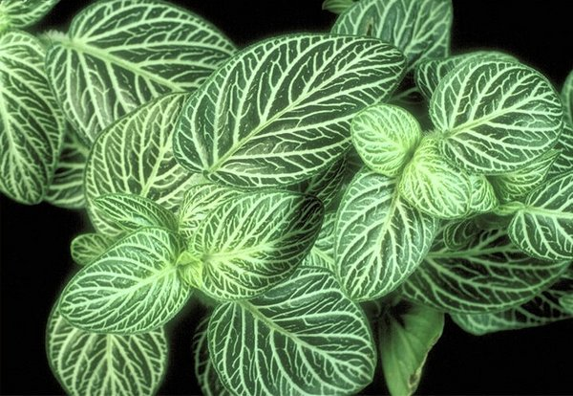
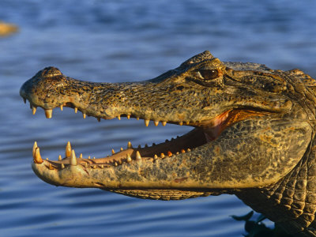
Taxonomy (continued)
“Five kingdom” system was used for many years (even when I was a kid!)
Monera
Protista
Fungi
Plantae
Animalia

Slide 58
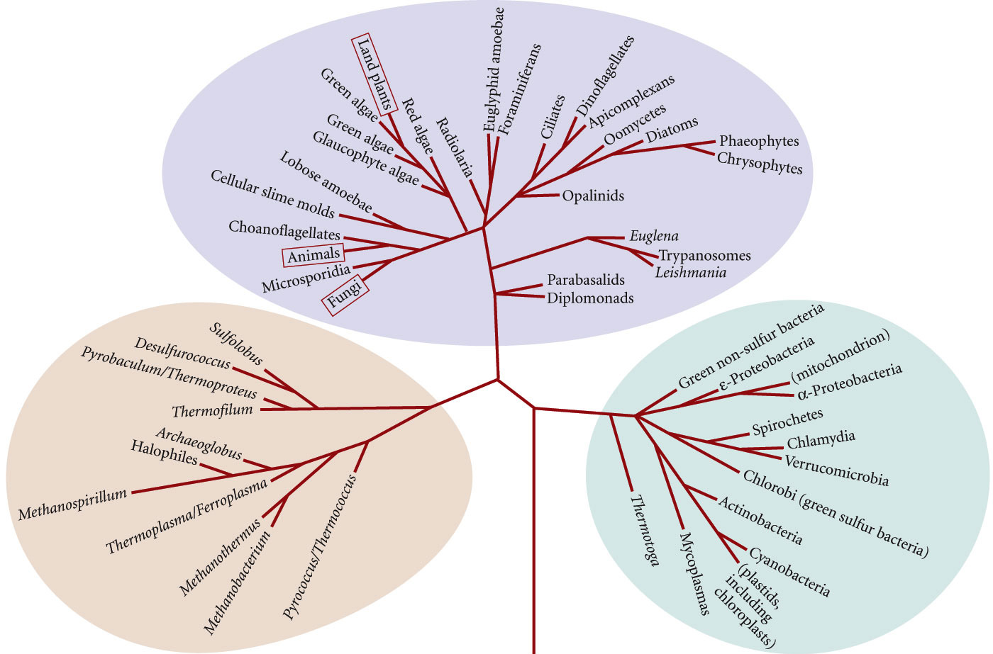
Taxonomy (continued)
“Five kingdom” system was used for many years (even when I was a kid!)
Three domain system:
Eukarya
Archaea Bacteria

Slide 59
Taxonomy (continued)
One purpose of taxonomy is to name species
Modern species taxonomy started with Carl Linnaeus.
First introduced binomial nomenclature in his 1753 “Species Plantarum” and 1758 “Systema Naturae” editions.

Slide 60
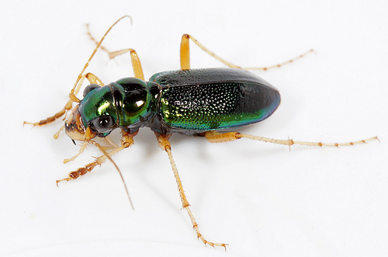
Taxonomy (continued)
One purpose of taxonomy is to name species
Modern species taxonomy started with Carl Linnaeus.
First introduced binomial nomenclature in his 1753 “Species Plantarum” and 1758 “Systema Naturae” editions.
Each species name has two parts:
Megacephala virginica

Slide 61
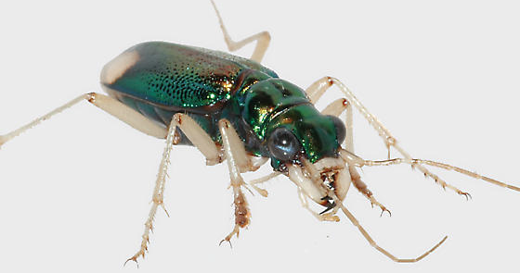
Taxonomy (continued)
One purpose of taxonomy is to name species
Modern species taxonomy started with Carl Linnaeus.
First introduced binomial nomenclature in his 1753 “Species Plantarum” and 1758 “Systema Naturae” editions.
Each species name has two parts:
Megacephala virginica
Megacephala carolina

Slide 62
Taxonomy and Systematics
1) Some terminology
2) Taxonomy: concepts and history
3) Systematics and phylogenetic trees
4) Methods of inferring phylogenies

Slide 63
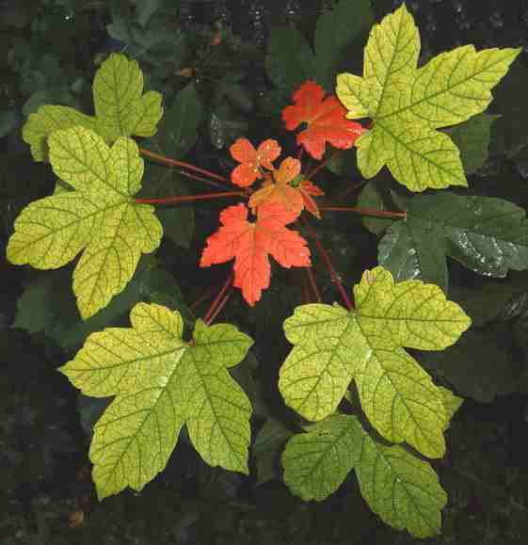
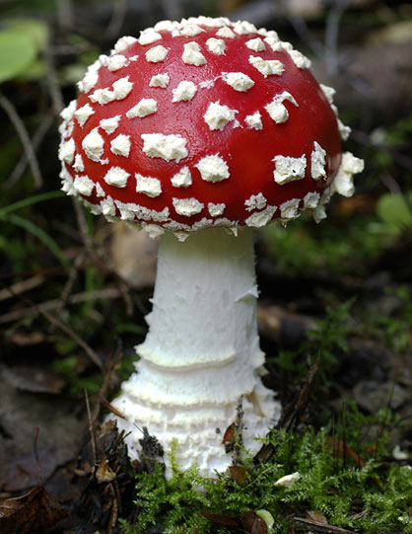
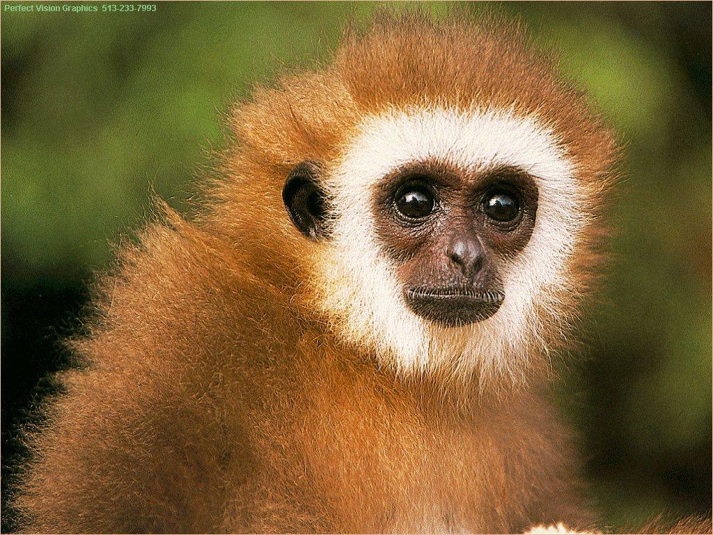
How can studying systematics possibly be interesting?
Relatedness? The resulting pathway is interesting of itself (who is most closely related to who? Are dogs more closely related to cats or to pigs?) Sometimes results are surprising…

Slide 64
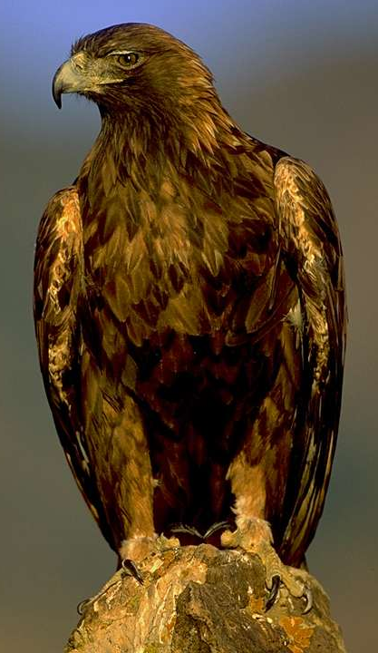
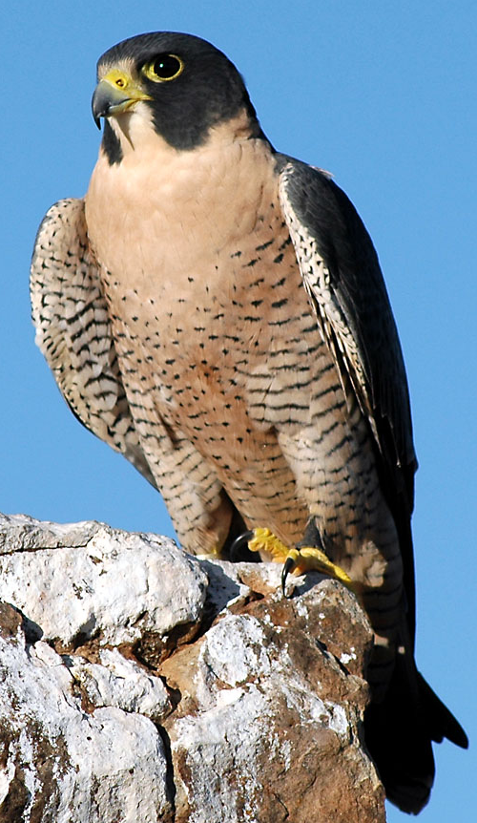
How can studying systematics possibly be interesting?

Slide 65


How can studying systematics possibly be interesting?

Slide 66


How can studying systematics possibly be interesting?

Slide 67

How can studying systematics possibly be interesting?

Slide 68
How can studying systematics possibly be interesting?
Relatedness? The resulting pathway is interesting of itself (who is most closely related to who? Are dogs more closely related to cats or to pigs?) Sometimes results are surprising…
Trait evolution? Phylogenetic trees provide a foundation for understanding many aspects of evolutionary history, such as the pathways by which various characters evolved (how many times did wings evolve?)
Cutting edge technology? Use of molecular data, including whole genome sequences
Detective work? Unlike some aspects of evolution, we cannot often directly observe evolutionary history. Instead, we must infer it using phylogenetic methods, like Sherlock Holmes reconstructing the history of a crime…
Notes:
Three-taxon statement

Slide 69


Slide 70

There are many ways to represent phylogenetic trees…

Slide 71
There are many ways to represent phylogenetic trees…
Rotating the branches does not change the relationships!
A
C
B
=
B
C
A
D
D

Slide 72
Phylogenetic tree terminology
Root: the common ancestor of all taxa
Node: a branchpoint in a tree
Clade: a group of two or more taxa that includes both their common ancestor and all their descendents
Node
Root

Slide 73
Phylogenetic tree terminology
Root: the common ancestor of all taxa
Node: a branchpoint in a tree
Clade: a group of two or more taxa that includes both their common ancestor and all their descendents
Node
Clade
Root

Slide 74
Phylogenetic tree terminology
Root: the common ancestor of all taxa
Node: a branchpoint in a tree
Clade: a group of two or more taxa that includes both their common ancestor and all their descendents
Node
Root
Clade

Slide 75
Phylogenetic tree terminology
Monophyletic group: A taxon that is a clade. A group that includes ALL of the descendants of a common ancestor.
Monophyletic

Slide 76



Phylogenetic tree terminology
Paraphyletic group: A group that includes some, but not all, of the descendants of a common ancestor.
Polyphyletic group: A group that consists of members of multiple evolutionary lineages, but not not include the most recent common ancestor and all of its descendants.

Slide 77




Phylogenetic tree terminology
Paraphyletic group: A group that includes some, but not all, of the descendants of a common ancestor..

Slide 78
Phylogenetic tree terminology
Paraphyletic group: A group that includes some, but not all, of the descendants of a common ancestor.
Polyphyletic group: A group that consists of members of multiple evolutionary lineages, but not not include the most recent common ancestor and all of its descendants.

Slide 79
Taxonomy and Systematics
1) Some terminology
2) Taxonomy: concepts and history
3) Systematics and phylogenetic trees
4) Methods of inferring phylogenies

